Slide 1
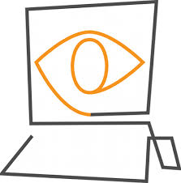

Computer Vision
START
Prudvi raj

Slide 2
Computer Vision?
Teaching computers to see.

Slide 3
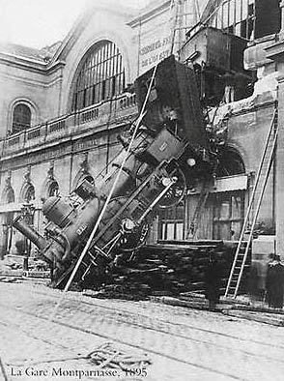
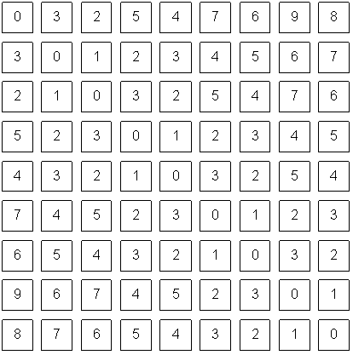
Computer vision vs human vision
What we see
What a computer sees

Slide 4
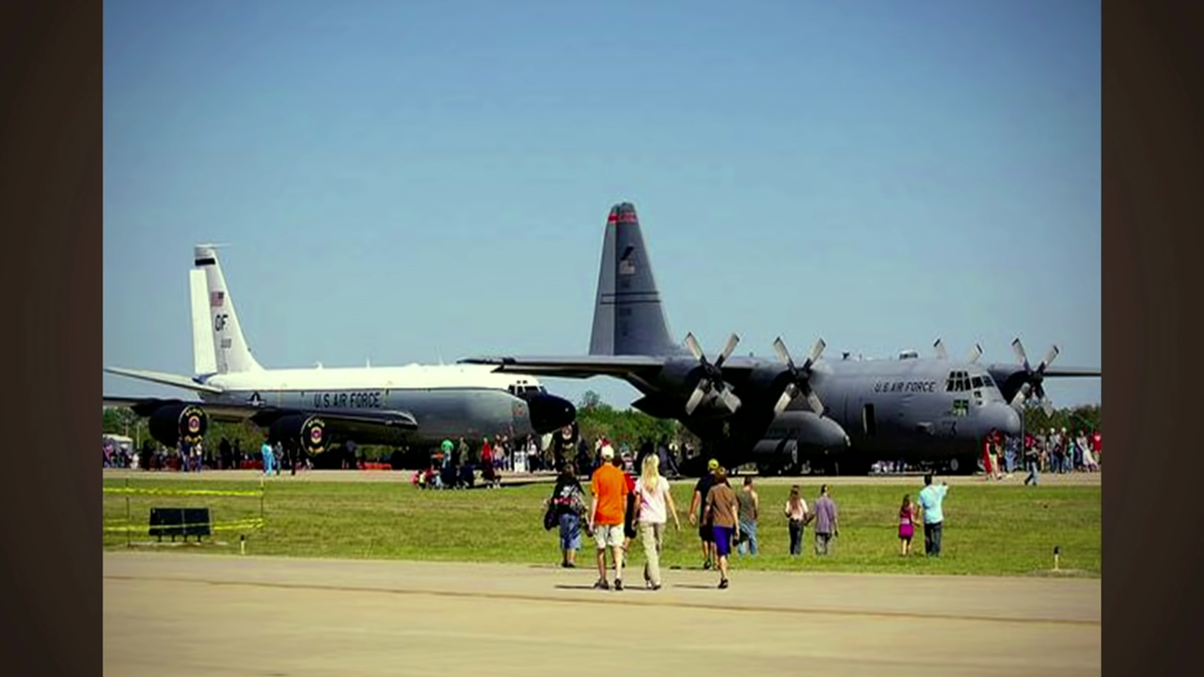
VISION & RECOGNITION

Slide 5
Simple Question...
Is Computer vision necessary?
Design computers that can see (that is understand and interpret information in image/video)
✓
Digital content Everywhere...!

Slide 6
Timelines
A brief insight into history...

Slide 7
A little story about Computer Vision
In 1966, Marvin Minsky at MIT asked his undergraduate student Gerald Jay Sussman to “spend the summer linking a camera to a
computer and getting the computer to describe what it saw”.He then knew that the problem is more difficult.

Slide 8
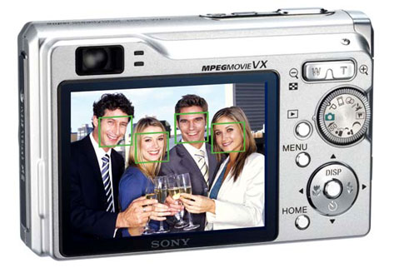
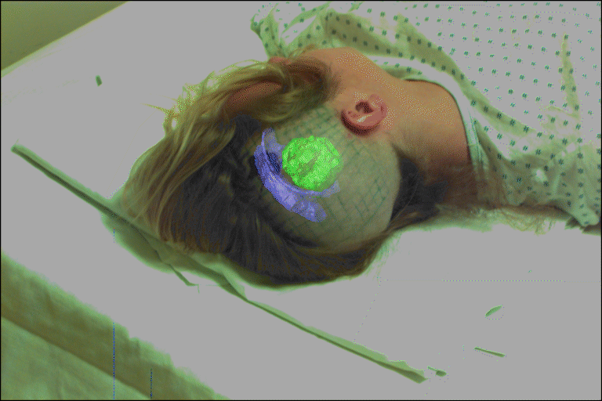
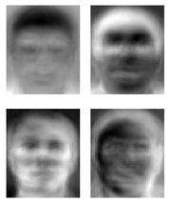
History of computer vision:
1960’s: interpretation of synthetic worlds
1966: Minsky assigns computer vision as an undergrad summer project
1970’s: some progress on interpreting selected images
1980’s: ANNs come and go; shift toward geometry and increased mathematical rigor
1990’s: face recognition; statistical analysis in vogue
2000’s: broader recognition; large annotated datasets available; video processing starts; vision & graphis; vision for HCI; internet vision, etc.

Slide 9
Related disciplines
Image Processing
Scientific / medical imaging
Pattern Recognition
Computer Graphics(AR & VR)
Learning
Artificial Intelligence
Visual Neuroscience

Slide 10

Components of a computer vision system
Camera
Lighting
Computer
Scene
Scene Interpretation

Slide 11
Critical Issues
Sensing: how do sensors obtain images of the world?
Information: how do we obtain color, texture, shape, motion, etc.?
Representations: what representations should/does a computer [or brain] use?
Algorithms: what algorithms process image information and construct scene descriptions?

Slide 12
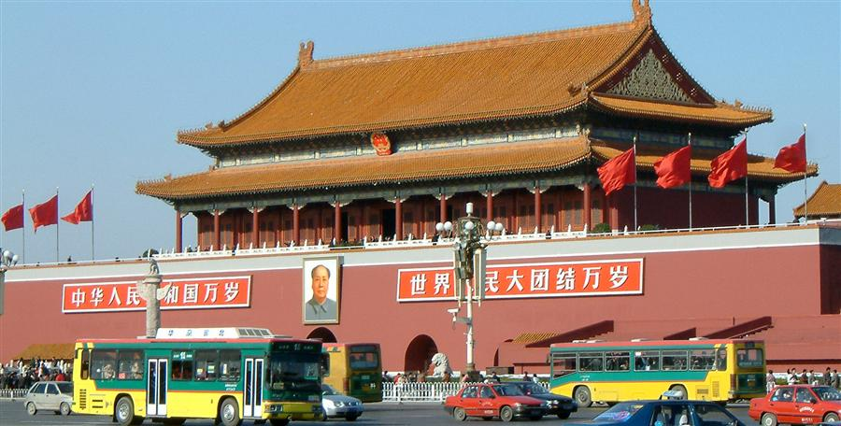
Vision as a source of semantic information

Slide 13
Object categorization
sky
building
flag
face
banner
wall
street lamp
bus
bus
cars

Slide 14
Scene and context categorization
outdoor
city
traffic
house
…

Slide 15
Qualitative spatial information
slanted
non-rigid moving object
vertical
rigid moving object
rigid moving object
horizontal

Slide 16
Applications
3D Modeling
Self driving cars
Surveillance
Security
Image search
Video analyzer
Image recognition
Photo enhance
Facial recognition

Slide 17



Computer vision as API

Slide 18
REST API & JSON
Representational State Transfer API
JavaScript Object Notation

Slide 19
Thank You
END
Prudvi raj

